Slide 1

SAP BTP ABAP on Cloud / RAP Training
DAY-16
Anubhav Oberoy
www.AnubhavTrainings.com
Follow excellence with sheer passion

Slide 2


DISCLAIMER
The training content and delivery of this presentation is confidential, and cannot be recorded, or copied and distributed to any third party, without the written consent of Anubhav Trainings

Slide 3

01
Custom Entity
Service consumption model
02
03
Access External API
04
Consume API
Notes:
https://pixabay.com/photos/san-francisco-transamerica-pyramid-1633203/

Slide 4
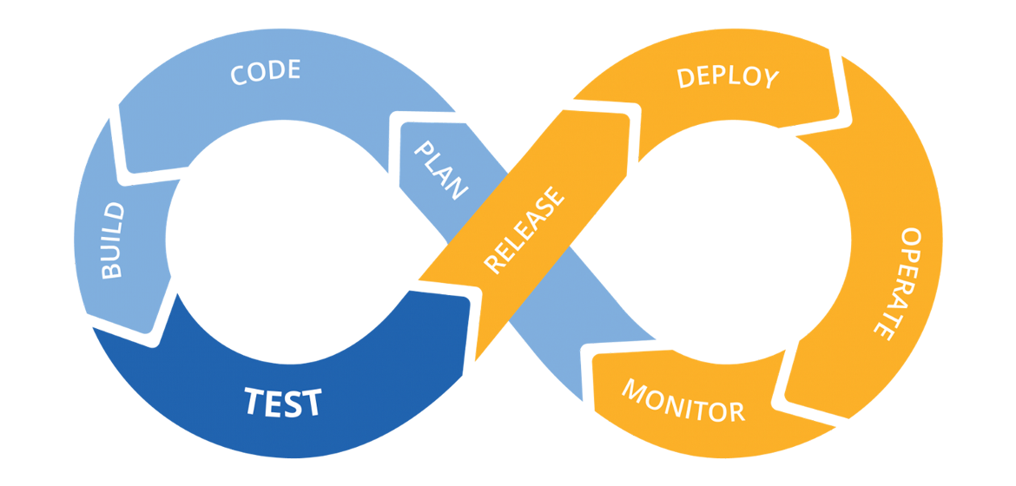
Hands on: Continuous Integration

Slide 5
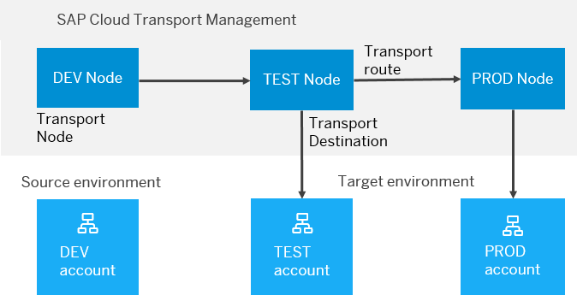
BTP Cloud Transport Management
SAP Cloud Transport Management service lets you manage software deliverables between accounts of different environments (such as Neo and Cloud Foundry), by transporting them across various runtimes. This includes application artifacts as well as their respective application-specific content.
SAP Cloud Transport Management service adds transparency to the audit trail of changes so that you get information about who performed which changes in your production environment, and when they did it. At the same time, the service enables a separation of concerns: For example, a developer of an application or of SAP Cloud content artifacts can trigger the transport of changes in a development subaccount, while the resulting import into the test, and production subaccount is handled by a central operations team.

Slide 6
Steps to implement the approver scenario
Go to base behavior definition and add non factory actions, provide implementation for the same
Create copy from processor cds entity projections and make new cds entities for projection for approver. Both travel and booking, ignore the booking supplement as a approver will only allowed to view upto the booking data.
Create metadata extensions for approver. Since approver can only see the data of travel and booking, we only created 2 MDE. Keep all the relevant fields and integrate code to show accept and reject travel buttons.
Now we provide behavior definition projection for approver which controls what an approver can do. As we know an approver can only edit bookingfee and travel status, he/she not allowed to create/update/delete any of the entities.
Customize our BDEF according to the needs of our user scenario.
Create a service definition for approver and service binding for approver.
Testing ☺
www.anubhavtrainings.com

Slide 7
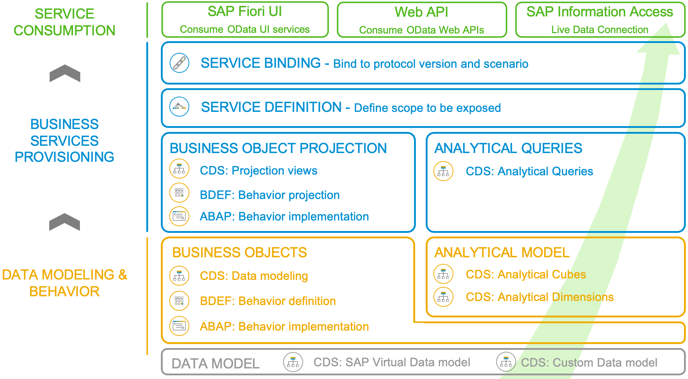
Development Flow of Scenario
With the 2102 release, the SAP BTP ABAP Environment opened up the door for analytics developments. The programming model follows the same “RAP” paradigm as in the transactional world: The entity model is implemented with CDS views that make use of additional analytical annotations that were now also released for the usage in the BTP ABAP Environment ("Steampunk”). As there is no access to the analytical backend transactions nor to the analytical key user tools, an analytical preview was also introduced, so that a developer can test his developments directly in the ABAP Development Tools. Another novelty is the introduction of an analytical service exposure. For an analytical service to be used as real time connection with a supported client (like e.g., SAP Analytics Cloud), the SAP Information Access protocol (InA) is required whereas transactional services rely on the OData protocol.
www.anubhavtrainings.com

Slide 8
www.anubhavtrainings.com
Thank You
End of Day 16
www.anubhavtrainings.com

Slide 9


We’re committed to empower you to be
#FutureReady
through powerful training solutions.
We build the workforce of the future.
250+
Corporate Clients
30,000+
Learners Trained
25000+
Learners Placed
FREE WEBINARS
Sign up for free webinars with industry experts every fortnight!
Enroll Now!
Contact us today!
https://anubhavtrainings.com

